Slide 1
Project Management
Understanding Project Management principles
March 2019

Slide 2

Introduction
Eric Lemmons, PMP
Senior Technical Account Manager
Microsoft
Sharyn Lemmons, PMP, CBCP
Senior Manager – Business Continuity Team
Express Scripts, Inc. (a division of Cigna)
Gary Obernuefemann
Project Manager
KellyMitchell Group
Notes:
Gary O. - I earned my undergraduate in 1982. I earned my MBA here at UMSL in ’88. I have been doing PM since 94.
Sharyn - I earned my undergraduate degree in 1986 and my masters in 1988 from Mizzou - both in Computer Science. I have been doing project management work since about 1991. I received my PMI Certification in 2003.
Eric - Graduated from UMSL in ’95 with a BSBA and an MIS emphasis … and never had Dr. Sauter. I have been doing PM since 1997. Earned my PMP certification in 2003.
Our opinions only. However, we developed our presentation based on our experience and utilizing the PMI (Project Management Institute) - PMBOK.

Slide 3
Overview of Summer Internship Program at Express Scripts
May 20th –
August 9th
2019
https://careers.express-scripts.com/us/en/students

Slide 4


Today’s Goal and Agenda
Present Project Management and discuss the relationship between Analysis and Design and Project Management
Notes:
Analysis and design are only two pieces in a process to create a successful piece of software.
One of the other pieces is project management. Our goal for today is to give you an appreciation for what project management is all about and how it relates to your project.
We want to help you understand the relationship between the planning you are used to doing in your head with the formal planning required in Project Management.

Slide 5

Your Turn
When someone says ‘project’ what comes to mind?
What is your class project assignment?
What is the hardest thing about your project?
What has been the biggest surprise so far about your project?

Slide 6

Project Definition
A project is a temporary endeavor undertaken to create a Unique product or service.
Notes:
Building a building
Creating software
Running a campaign for political office
Starting a new business.

Slide 7

Project Characteristics
Performed by People
Constrained by Resources
Planned, Executed and Controlled
Temporary and Unique (as opposed to operations, which are ongoing and repetitive)

Slide 8

Successful Project
Meets or exceeds the customers requirements
Delivered on time
Within Budget
Notes:
The problem isn’t in the definition of ‘success’, it is in the definition of ‘failure’.
If a project is 1 month late or 5% over budget, is that a failure or just disappointment?
Was HealthCare.Gov a complete failure (from a rollout, not a political perspective)?

Slide 9
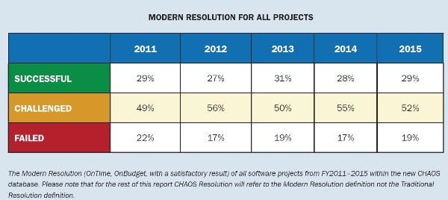
Standish Group 2015 CHAOS Report
The Standish Group (a Project Management Company) does a yearly report on Project Management. In their 2015 report:
https://www.infoq.com/articles/standish-chaos-2015
Notes:
Successful (on time, on budget with a satisfactory result) ,
Challenged (delivered late, over budget, and/or with less than the required features and functions),
Failed (cancelled prior to completion or delivered and never used).
That means 71% of projects are ‘challenged’ in some way.
Been doing this since 1994. Now Standish has a vested interest in reporting failures (because they sell a PM methodology) and others are debunking their definitions, data gathering/selecting techniques, and how they interpret the data but I won’t argue with their overall ranking numbers. A lot of projects have problems!!

Slide 10
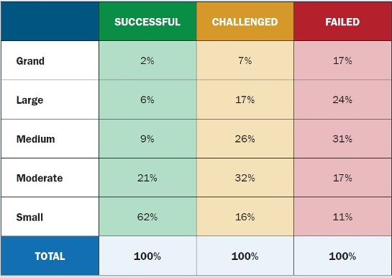
Standish Group 2015 CHAOS Report
Smaller projects have a higher likelihood of success than larger projects.
https://www.infoq.com/articles/standish-chaos-2015
Notes:
Smaller is better!

Slide 11
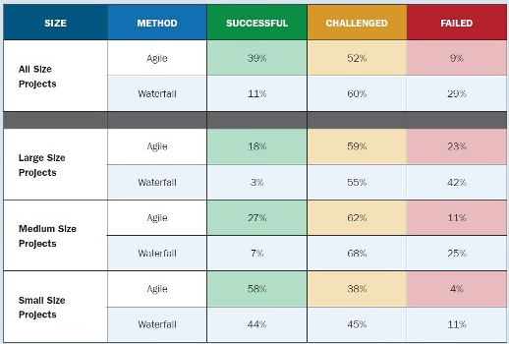
Standish Group 2015 CHAOS Report
Across all project sizes, Agile approaches resulted in more successful projects and less outright failures than Waterfall.
https://www.infoq.com/articles/standish-chaos-2015
Notes:
If builder built buildings the way that Project Managers ran projects the first termite that came along would destroy civilization!

Slide 12
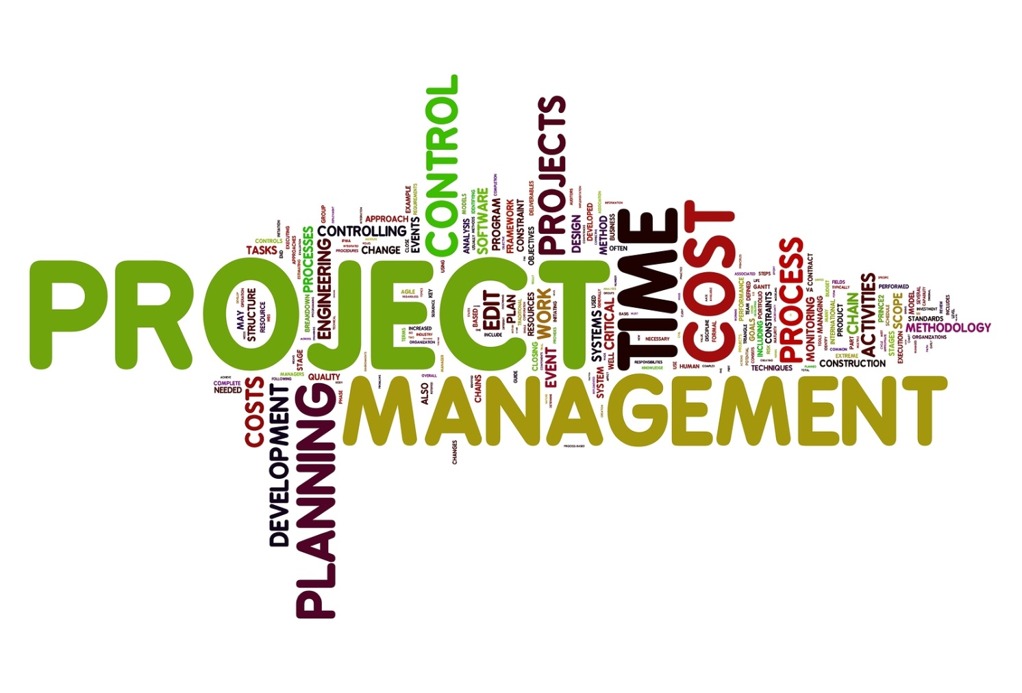
Project Management
The application of knowledge, skills, tools, and techniques to project activities to deliver a successful project.

Slide 13


Project Management Vs. Project Methodology
Methodologies give you templates of things to do
Project management applies them to this project
Notes:
What is needed for THIS project?
Does it save me time?
Is it a deliverable?
Does it contribute to the effectiveness of a later deliverable?
Good for people development?

Slide 14
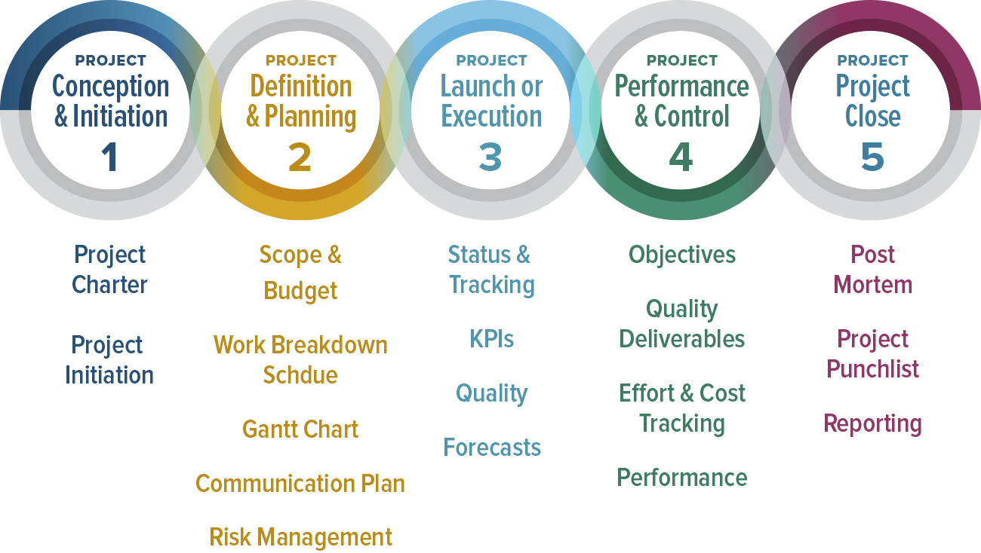
5 Project Stages/Processes
Notes:
Conception & Initiation - Charter and Procedures
Definition & Planning - Defining activities and developing the plan
Execution - Carry out the plan. The product is created here.
Performance & Control- Tracking, Tracking, Tracking.
Project Close- Discontinue operation of the project in an orderly, controlled manner. Lessons Learned. Reassign people, not fired!

Slide 15

Project to Development Relationship Model
Development Life Cycle
PM Stages / Processes
Conception & Initiation
Performance
&
Control
Analysis
Definition and Planning
Design
Execution
Construction
Close-Down
Notes:
On the left is what you have been studying.
On the right is how it maps to the PM stages.
Each stage is iterative so it gets confusing!

Slide 16

Roles of a Project Manager
Planner
Coordinator
Leader
Negotiator
Communicator
Notes:
Others!
Cheerleader
Confessor
Task Master
Protector
90% of PM is communications!!

Slide 17
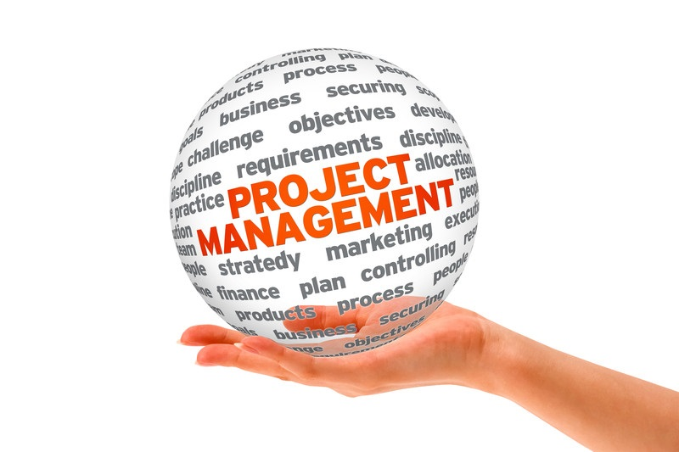
Project Management Functions
Scope Management
Risk Management
Communications Management
Schedule Management
Human Resource Management
Quality Management
Cost Management
Procurement Management
Integration Management
Notes:
9 Project Management Functions
Scope - Shared expectations, Change Control, Making sure all required work, and only required work, is done.
Risk - Identification, Assessment, and Mitigation
Communication - Internal, External, When, Whom, What, How. Customer Relations
Schedule - On-Time. Proving it. Various calculations.
Human Resource - People
Quality - Plan for it. Be able to Prove it. Standards. Eyes of the beholder.
Cost - Budget vs. Actual. Various calculations.
Procurement – Subcontractor
Integration- Plan, Execute, Coordinate

Slide 18
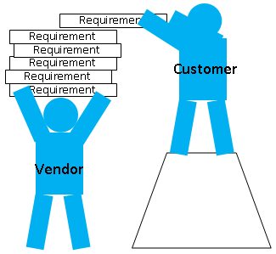
Scope Management
Ensure that the project includes all the work required, and only the work required, to complete the project successfully.
Notes:
Project Scope is everything that goes into creating the product. What are you going to do and deliver (e.g., it includes testing, implementation, ...).
Requirements are what the user specifies as being needed. They can be functional, performance, quality, or process related.
No Gold Plating!!
No good deed goes unpunished.
What is the relationship between the requirements and the project scope?

Slide 19

Scope
Have you or can you develop a 3 Sentence Scope Statement for your project?
If not, what do you need to complete one?
Notes:
Do you have one? Do you know your scope?

Slide 20
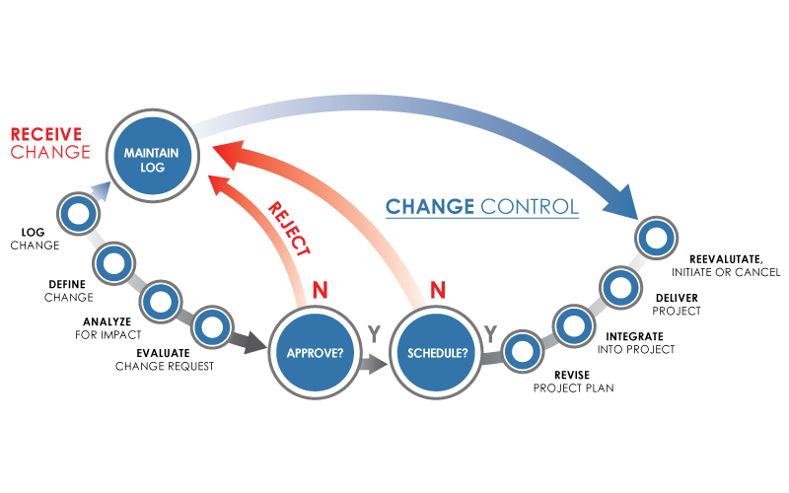
Change Control
Ensure that changes are agreed upon.
Determine when scope change is desired/has occurred.
Managing the change through all other processes (schedule, cost, quality).
Notes:
Change in a project is inevitable and it is NOT bad. However, it must be managed!

Slide 21
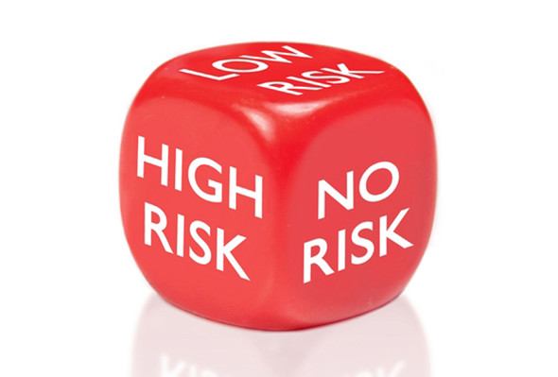
Risk Management
The process of identifying, analyzing, and responding to project risk.
Risk is an uncertain event or condition that will have an effect on the project. It has a cause and an effect and a consequence to cost, schedule, or quality.
What is the biggest risk on your project?
Notes:
Identify
Analysis
Mitigation
Monitor and Control
Known vs. Unknown
Risk vs. Reward (fast schedule)
Not just CYA

Slide 22

Communications Management
Ensure the timely and appropriate generation, collection, dissemination, storage, and ultimate disposition of project information.
Who needs to know what? When do they need to know it? How will it be communicated and by Whom?
Notes:
Sending and Receiving Communication
Have to plan up front
Across all levels and organizations
Appropriateness!!!

Slide 23

Communications Management
What is your communication plan?
What is the Frequency/Method/Content of communication with
Dr. Sauter?
The Customer?
Each other?
Notes:
Who is responsible to make sure it gets done?

Slide 24
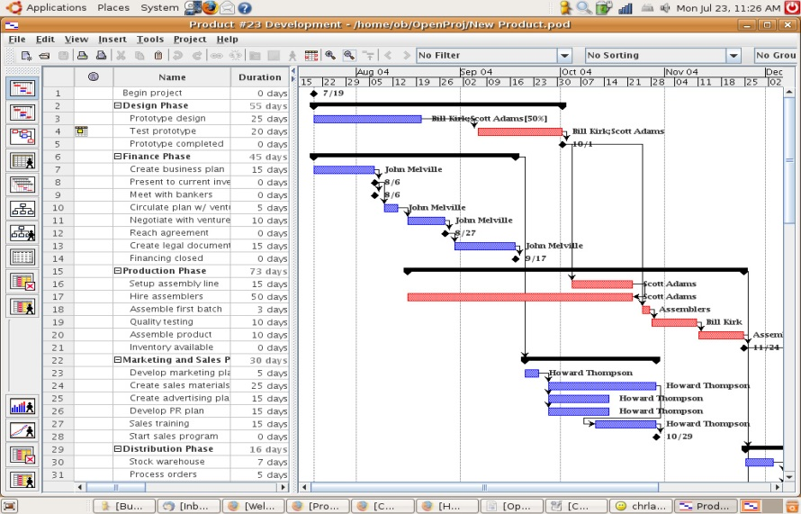
Schedule Management
Ensure the timely completion of the project.
  Identify the specific activities that must be performed to meet deliverables.
  Document dependencies
  Estimate the time to complete an activity
  Schedule development (start and end dates)
  Schedule control
What is the Critical Path/Milestones for your class project?
Notes:
Know where you are at!
Know your critical path!
Some think this is Project Management. It is only one piece.

Slide 25

Schedule Management
When is your next deliverable due TO:
  Dr. Sauter?
  The customer?
When is your final delivery due TO:
  Dr. Sauter?
  The customer?
What is your critical path and who is on it?

Slide 26
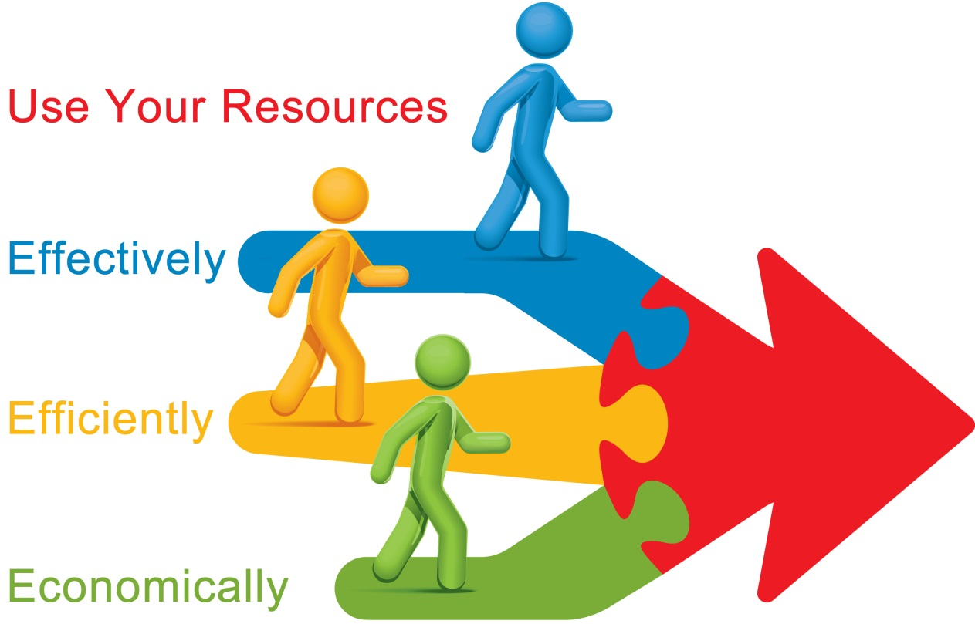
Resource Management
Make the most effective use of the people involved in the project.
Planning
Acquisition
Development
Notes:
This involves sponsors, end users, suppliers, individual performers.

Slide 27
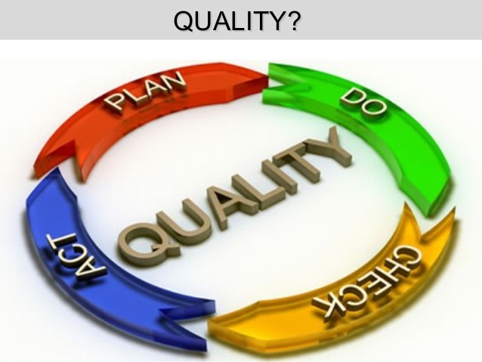
Quality Management
The processes required to ensure the project will satisfy the needs for which it was undertaken.
  Identify what to measure
  Periodically review the project
  Monitor specific results to determine if they meet the relevant quality standards.
Notes:
Sox? Planned quality. Not Testing.
ISO9000
CMMI
Six Sigma
Walkthroughs
Sign offs
Coding Standards
Meeting Minutes

Slide 28

Cost Management
Ensure the project is completed within the approved budget
Notes:
Resources
Experience levels
Vacation, Sick, Quit
Equipment
Hardware, Software, Office Space, Copiers, Phones
Software licenses (for the customer or the project)
What you use
Cycles, Electricity, ...
Fixed Price, T&M, Fixed Resources
Define what is included and what isn’t.

Slide 29
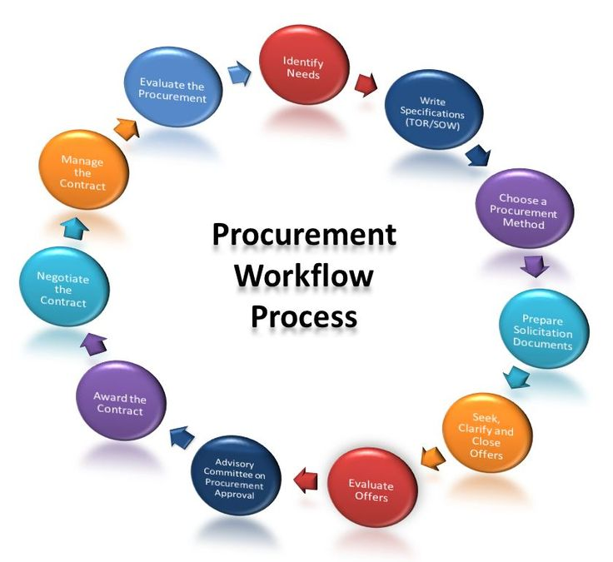
Procurement Management
Acquire goods and services to attain project activities from outside the performing organization.
also Known As:
Vendor Management
Subcontractor Management
Supplier Management
Notes:
Getting more important!! This can be used to transfer or mitigate risk
Procurement Planning - what is needed when
Solicitation Planning - requirements
Solicitation
Selection
Administration
Closeout

Slide 30
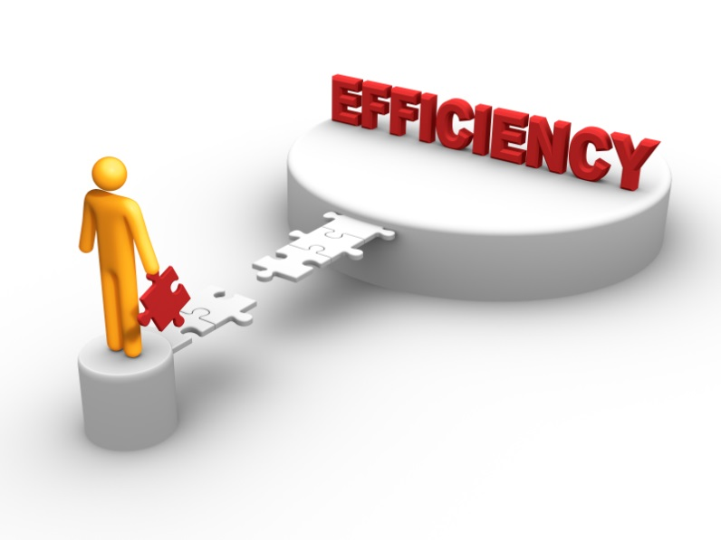
Characteristics of Effective Project Management
Effectively plan the project
Accurately monitor and communicate the project progress
Ensure that all requirements are met
Ensure the project is on time and within budget
Schedule resources effectively
Manage changes to the project
Notes:
How

Slide 31

What does all this mean to you?
You know what you are supposed to be working on and when it is due
You know what is going on in the project
You know how to communicate your status
You know the critical path items and the critical success factors for the project.

Slide 32
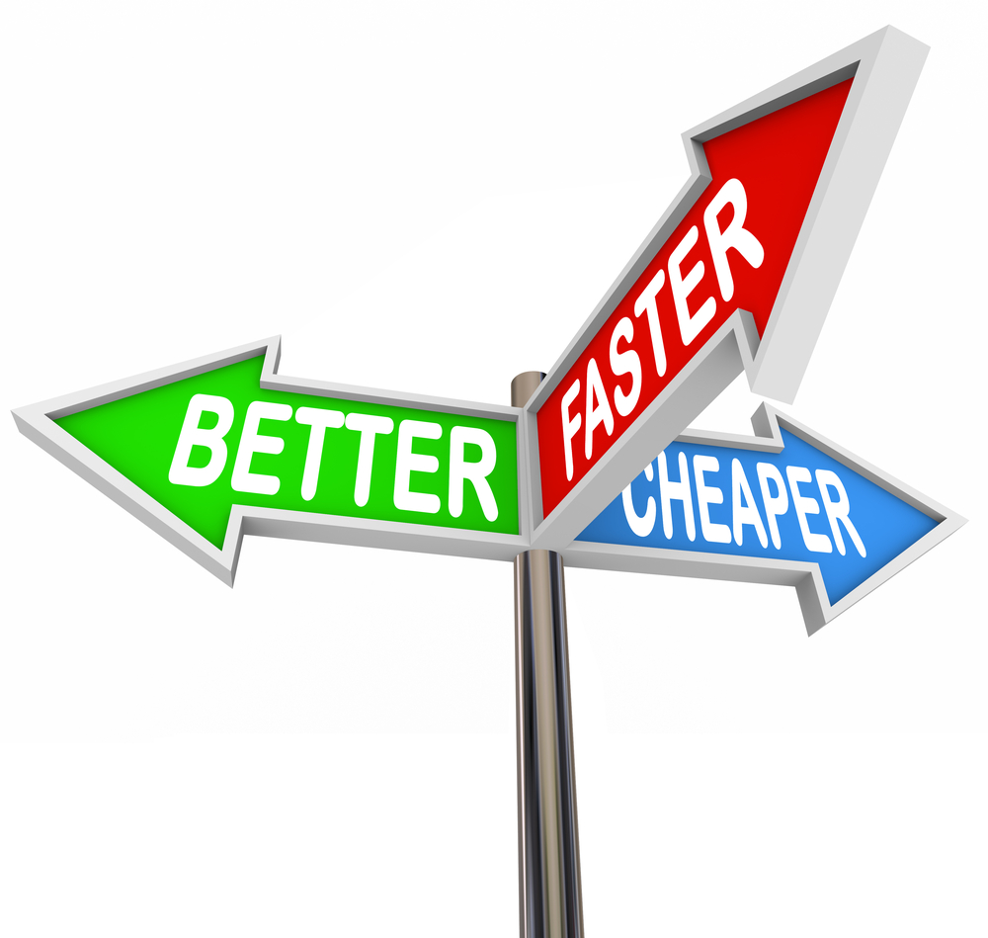
Benefits
Projects delivered on time and within budget that meet customers expectations.
No more death marches
Success can be duplicated. Failures can be learned from.
Return business

Slide 33
INF SYS 6847\LOM 6347 : PROJECT MANAGEMENT
Effective project management ensures that a project is completed on time, within budget, and has high quality. The purpose of this class is to examine the task of project resource management with a focus on IT and services. It will cover conventional aspects of project management, such as the project evaluation, planning, roles, responsibilities, scheduling, and tracking. In addition, this class will examine risk management, change management, critical chain management, build vs. buy analysis, package vs. custom solutions, vendor qualification and selection, and the roles of certification in the process. The class will also cover the management of programs or a portfolio of IT projects

Slide 34

To be successful in PM ...
USE a methodology and work with the customer, develop a plan and execute it with defined tools and procedures.
Piece of cake! ☺
Notes:
Stamp out unsuccessful projects!!

Slide 35

Questions/Comments?

